Slide 1

SIT1302 Internet Programming
UNIT 1
MARKUP LANGUAGE
Ms.J.S.Vimali
SIT1302 School of Computing

Slide 2
COURSE OUTCOMES:
CO1 : Implement interactive web page(s) using HTML, CSS and DHTML.
CO2 : Design and develop interactive Server Side executable web applications using Java Script.
CO3 : Demonstrate well-formed XML, XSLT, DTD and XSL.
CO4 : Build Dynamic web site using server side PHP Programming and Database connectivity.
CO5 : Create and use ASP.NET applications.
CO6 : Demonstrate web applications with Rich Web Controls.
SIT1302 School of Computing

Slide 3
DHTML
Stands for Dynamic HTML, it is totally different from HTML.
The browsers which support the dynamic HTML are some of the versions of Netscape Navigator and Internet Explorer of version higher than 4.0.
The DHTML is based on the properties of the HTML, javascript, CSS, and DOM (Document Object Model which is used to access individual elements of a document) which helps in making dynamic content.
It is the combination of HTML, CSS, JS, and DOM.
The DHTML make use of Dynamic object model to make changes in settings and also in properties and methods.
It also makes uses of Scripting and it is also part of earlier computing trends.
SIT1302 School of Computing

Slide 4
DHTML allows different scripting languages in a web page to change their variables, which enhance the effects, looks and many others functions after the whole page have been fully loaded or under a view process, or otherwise static HTML pages on the same.
But in true ways, there is noting that as dynamic in DHTML, there is only the enclosing of different technologies like CSS, HTML, JS, DOM, and different sets of static languages which make it as dynamic.
DHTML is used to create interactive and animated web pages that are generated in real-time, also known as dynamic web pages so that when such a page is accessed, the code within the page is analyzed on the web server and the resulting HTML is sent to the client’s web browser.
SIT1302 School of Computing

Slide 5
HTML: HTML stands for Hypertext Markup Language and it is a client-side markup language. It is used to build the block of web pages.
Javascript: It is a Client-side Scripting language. Javascript is supported by most of the browser, also have cookies collection to determine the user needs.
CSS: The abbreviation of CSS is Cascading Style Sheet. It helps in the styling of the web pages and helps in designing of the pages. The CSS rules for DHTML will be modified at different levels using JS with event handlers which adds a significant amount of dynamism with very little code.
DOM: It is known as a Document Object Model which act as the weakest links in it. The only defect in it is that most of the browser does not support DOM. It is a way to manipulate the static contents.
SIT1302 School of Computing

Slide 6
Key Features: Following are the some major key features of DHTML:
Tags and their properties can be changed using DHTML.
It is used for real-time positioning.
Dynamic fonts can be generated using DHTML.
It is also used for data binding.
It makes a webpage dynamic and be used to create animations, games, applications along with providing new ways of navigating through websites.
The functionality of a webpage is enhanced due to the usage of low-bandwidth effect by DHTML.
DHTML also facilitates the use of methods, events, properties, and codes.
SIT1302 School of Computing

Slide 7
Why DHTML?
DHTML makes a webpage dynamic but Javascript also does, the question arises that what different does DHTML do? So the answer is that DHTML has the ability to change a webpages look, content and style once the document has loaded on our demand without changing or deleting everything already existing on the browser’s webpage.
DHTML can change the content of a webpage on demand without the browser having to erase everything else, i.e. being able to alter changes on a webpage even after the document has completely loaded.
SIT1302 School of Computing

Slide 8
Advantages:
Size of the files are compact in compared to other interactional media like Flash or Shockwave, and it downloads faster.
It is supported by big browser manufacturers like Microsoft and Netscape.
Highly flexible and easy to make changes.
Viewer requires no extra plug-ins for browsing through the webpage that uses DHTML, they do not need any extra requirements or special software to view it.
User time is saved by sending less number of requests to the server. As it is possible to modify and replace elements even after a page is loaded, it is not required to create separate pages for changing styles which in turn saves time in building pages and also reduces the number of requests that are sent to the server.
It has more advanced functionality than a static HTML. it is capable of holding more content on the web page at the same time.
SIT1302 School of Computing

Slide 9
Disadvantages:
It is not supported by all the browsers. It is supported only by recent browsers such as Netscape 6, IE 5.5, and Opera 5 like browsers.
Learning of DHTML requires a lot of pre-requisites languages such as HTML, CSS, JS, etc should be known to the designer before starting with DHTML which is a long and time-consuming in itself.
Implementation of different browsers are different. So if it worked in one browser, it might not necessarily work the same way in another browser.
Even after being great with functionality, DHTML requires a few tools and utilities that are some expensive. For example, the DHTML text editor, Dreamweaver. Along with it the improvement cost of transferring from HTML to DHTML makes cost rise much higher.
SIT1302 School of Computing

Slide 10
Difference between HTML and DHTML:
HTML is a markup language while DHTML is a collection of technologies.
HTML is used to create static webpages while DHTML is capable of creating dynamic webpages.
DHTML is used to create animations and dynamic menus but HTML not used.
HTML sites are slow upon client-side technologies whereas DHTML sites are comparatively faster.
Web pages created using HTML are rather simple and have no styling as it uses only one language whereas DHTML uses HTML, CSS, and Javascript which results in a much better and way more presentable webpage.
HTML cannot be used as server side code but DHTML used as server side code.
DHTML needs database connectivity but not in case of HTML.
Files in HTML are stored using .htm or .html extension while DHTML uses .dhtm extension.
HTML requires no processing from the browser but DHTML does.
SIT1302 School of Computing

Slide 11
HTML id Attribute
The HTML id attribute is used to specify a unique id for an HTML element.
You cannot have more than one element with the same id in an HTML document.
The HTML id attribute is used to specify a unique id for an HTML element.
You cannot have more than one element with the same id in an HTML document.
Using The id Attribute
The id attribute specifies a unique id for an HTML element. The value of the id attribute must be unique within the HTML document.
The id attribute is used to point to a specific style declaration in a style sheet. It is also used by JavaScript to access and manipulate the element with the specific id.
The syntax for id is: write a hash character (#) character, followed by an id name. Then, define the CSS properties within curly braces {}.
In the following example we have an <h1> element that points to the id name "myHeader". This <h1> element will be styled according to the #myHeader style definition in the head section.
SIT1302 School of Computing

Slide 12
<!DOCTYPE html>
<html>
<head>
<style>
#myHeader {
background-color: lightblue;
color: black;
padding: 40px;
text-align: center;
}
</style>
</head>
<body>
<h2>The id Attribute</h2>
<p>Use CSS to style an element with the id "myHeader":</p>
<h1 id="myHeader">My Header</h1>
</body>
</html>
SIT1302 School of Computing

Slide 13
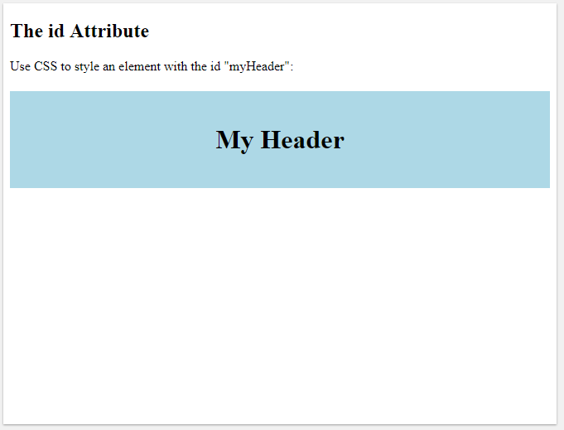
OUTPUT
SIT1302 School of Computing

Slide 14
HTML class Attribute
The HTML class attribute is used to specify a class for an HTML element.
Multiple HTML elements can share the same class.
Using The class Attribute
The class attribute is often used to point to a class name in a style sheet. It can also be used by a JavaScript to access and manipulate elements with the specific class name.
In the following example we have three <div> elements with a class attribute with the value of "city". All of the three <div> elements will be styled equally according to the .city style definition in the head section:
SIT1302 School of Computing

Slide 15
<!DOCTYPE html>
<html><head><style>
.city {
background-color: tomato;
color: white;
border: 2px solid black;
margin: 20px;
padding: 20px;}
</style></head>
<body>
<div class="city">
<h2>London</h2>
<p>London is the capital of England.</p></div>
<div class="city">
<h2>Paris</h2>
<p>Paris is the capital of France.</p></div>
<div class="city">
<h2>Tokyo</h2>
<p>Tokyo is the capital of Japan.</p>
</div></body></html>
SIT1302 School of Computing

Slide 16
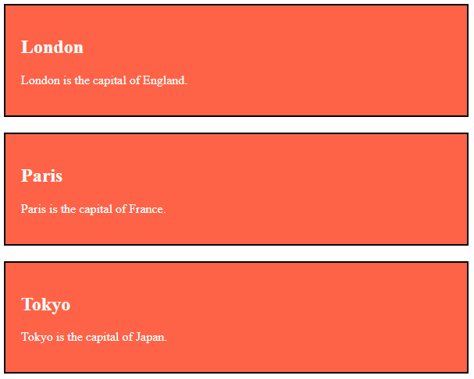
OUTPUT
SIT1302 School of Computing

Slide 17
<!DOCTYPE html>
<html>
<head>
<style>
.note {
font-size: 120%;
color: red;
}
</style>
</head>
<body>
<h1>My <span class="note">Important</span> Heading</h1>
<p>This is some <span class="note">important</span> text.</p>
</body>
</html>
SIT1302 School of Computing

Slide 18
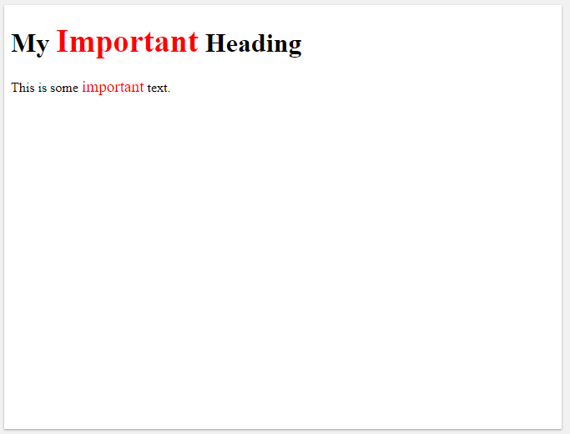
OUTPUT
SIT1302 School of Computing

Slide 19
<!DOCTYPE html>
<html><head><style>
#myHeader {
background-color: lightblue; color: black; padding: 40px; text-align: center;}
.city {
background-color: tomato; color: white; padding: 10px;}
</style></head>
<body>
<h2>Difference Between Class and ID</h2>
<p>A class name can be used by multiple HTML elements, while an id name must only be used by one HTML element within the page:</p>
<!-- An element with a unique id -->
<h1 id="myHeader">My Cities</h1>
<!-- Multiple elements with same class -->
<h2 class="city">London</h2>
<p>London is the capital of England.</p>
<h2 class="city">Paris</h2>
<p>Paris is the capital of France.</p>
<h2 class="city">Tokyo</h2>
<p>Tokyo is the capital of Japan.</p>
</body></html>
SIT1302 School of Computing

Slide 20
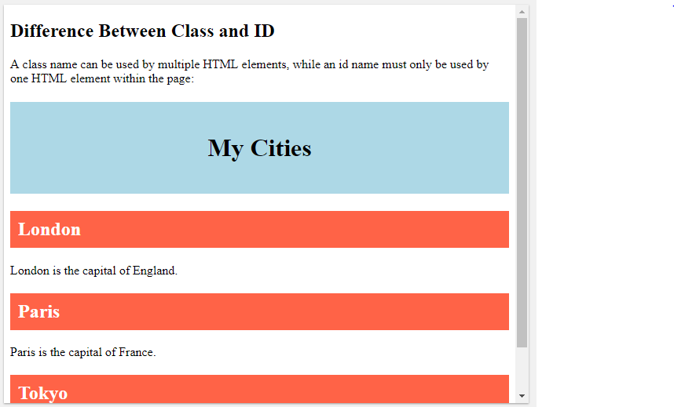
OUTPUT
SIT1302 School of Computing

